Slide 1
F# 3.0 – Strongly Typed Language Support for Internet-Scale Information Spaces
02 October 2012, SAP Research Don Syme
Principal Researcher, Microsoft Research UK

Slide 2
F# and Open Source
F# is open source
Apache 2.0 license
Mac, Linux, Windows, Browsers
Free Open-Source IDE Tooling with MonoDevelop
F# 3.0 now out
github.com/fsharp

Slide 3

A quick retrospective
1998
…
2012

Slide 4
1998 to 2012…
C#/VB Generics
PLDI 2001
C# 2.0
ECMA 2005
.NET 4.0 Tasks
OOPSLA ‘09
C# LINQ
SIGMOD2006
C# 3.0 Spec
.NET Generics
PLDI 2001
POPL 2004
ECMA 2005
.NET CLI
2.0-4.5
C#/VB
1.0-5.0
F# 2.0
Typescript
F# Core Lang
ML 2004
F# 1.0
C# Async
C# 5.0
F# Metaprog
ML 2006
F# 1.0
F# Active Patterns
ICFP 2007
Functional and Structural
Types for Javascript
F# Units of
Measure
POPL 2009
F# 2.0
F# Async/Agents
F# 2.0
PADL 2010
Notes:
.NET 2.0-4.0, C# 2.0-4.0: .NET Generics: deep innovation, heavily inspired by functional programming design & implementation, deeply empowering for C#/VB programmers. Generic programming, with total simplicity, with debugging, with runtime types, with unboxed efficiency, with precompilation. Assert this has put Microsoft 10-20 years ahead in this aspect of VM implementation: there is still no sign of JVM or other implementations or designs that rival the CLR on this design point. IMHO anyone who builds a typed VM language on anything less is building on sand.
C# 3.0-4.0: Lambda Expressions, LINQ. I had less to do with this, but it is fundamentally enabled by .NET generics. It is a wonderful and ground-breaking embedding of queries into languages
F# 2.0: Strongly typed functional programming for .NET, built on .NET Generics
F# 2.0: Units of Measure with effective type inference. Again, it feels Microsoft is 10-20 years ahead of the competition for this feature. Take that as a challenge, if you like.
F# 2.0: Asynchronous + parallel + agent programming. Smoothly integrated asynchronous programming and agents on a VM through local CPS rewriting. Similar to Kilim, predates it a little (2007).
C# 5.0: Look for a sneak preview next week!

Slide 5
Scala Extractors
(see F# active patterns)
Python Comprehensions
(see F# workflows)
Java Generics
(see .NET generics)
Java
Scala
Haskell
Python
Scala “Virtualization”
(see F# metaprog)
Haskell Monads
(see F# workflows)
Java Lambdas
(see Lisp/C#/F#...)
Scala “React”
(see F# async)
.NET CLI
2.0-4.0
C#
1.0-5.0
F#
2.0
Function types
(see F# FP/OO)
C++ Lambdas
(see Lisp ☺)
Javascript
Typescript
C
C++

Slide 6
1998 to 2012…
The dark days of object fundamentalism are past us ☺
Mixed OO/FP languages are now industry standard
(C#, C++, VB, Java, Typescript, Scala, F#, …)
MSR has played its part in this transformation

Slide 7
Today’s talk is very simple

Slide 8
Proposition 1 The world is information-rich

Slide 9
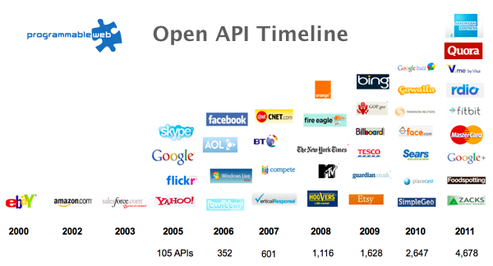
The Information Revolution

Slide 10
Proposition 2 Our languages are information-sparse

Slide 11
Proposition 3 This is a problem! (especially for strongly typed languages)

Slide 12
Proposition 4 There are exciting opportunities to make progress on this, together (especially for enterprise and internet information access)

Slide 13
Today (1) Demonstrate F# 3.0 (2) Themes in Scalable Information Rich Programming

Slide 14
But first, F# 1.0/2.0…

Slide 15
F# is…
...a productive, supported, interoperable, functional language that allows you to write simple code to solve complex problems.

Slide 16
F#
C#
let swap (x, y) = (y, x)
let rotations (x, y, z) =
[ (x, y, z);
(z, x, y);
(y, z, x) ]
let reduce f (x, y, z) =
f x + f y + f z
Tuple<U,T> Swap<T,U>(Tuple<T,U> t)
{
return new Tuple<U,T>(t.Item2, t.Item1)
}
ReadOnlyCollection<Tuple<T,T,T>> Rotations<T>(Tuple<T,T,T> t)
{
new ReadOnlyCollection<int>
(new Tuple<T,T,T>[]
{new Tuple<T,T,T>(t.Item1,t.Item2,t.Item3);
new Tuple<T,T,T>(t.Item3,t.Item1,t.Item2);
new Tuple<T,T,T>(t.Item2,t.Item3,t.Item1); });
}
int Reduce<T>(Func<T,int> f,Tuple<T,T,T> t)
{
return f(t.Item1)+f(t.Item2)+f(t.Item3);
}

Slide 17
Understanding F#
F# 1.0
F# 2.0
C# (designers)
F# (code)
WebSharper/
Javascript (HTML5)
F# 3.0
Code
Analysis
Algorithms
Parallel
Data
Information
Services
Presentation
Publication
UI

Slide 18
Example (power company)
I have written an application to balance the national power generation schedule for a portfolio of power stations to a trading position for an energy company. ...the calculation engine was written in F#.
The use of F# demonstrates a sweet spot for the language, namely data-rich analytical programming
Simon Cousins (power company)

Slide 19
Now, F# 3.0…

Slide 20
A Challenge! Task #1: A Chemistry Elements Class Library Task #2: A Biology Class Library Task #3: Repeat for all fields of human knowledge and endeavour…

Slide 21
Language Integrated Web Data
demo

Slide 22
World Bank Data
demo

Slide 23
What comes with F# 3.0?

Slide 24
SQL
type DB = SqlDataConnection<"Server='.\\SQLEXPRESS'..">
let db = DB.GetDataContext()
db.Customers
Fluent, Typed Access To SQL

Slide 25
OData
type Netflix = ODataService<"http://odata.netflix.com">
let service = Netflix.GetDataContext()
service.Titles
Fluent, Typed Access To OData

Slide 26
Web Services
type Svc = WsdlService<"http://www.xignite.com/xFutures.asmx?WSDL">
let financials = Svc.GetServiceContext()
financials.GetQuotes "IBM"
Fluent, Typed Access To WSDL

Slide 27
F# 3.0: Queries
let avatarTitles =
query { for t in netflix.Titles do
where (t.Name.Contains "Avatar")
select t }

Slide 28
F# 3.0: Queries
let avatarTitles =
query { for t in netflix.Titles do
where (t.Name.Contains "Avatar")
sortBy t.Name
select t }

Slide 29
F# 3.0: Queries
let avatarTitles =
query { for t in netflix.Titles do
where (t.Name.Contains "Avatar")
sortBy t.Name
select t
take 100 }

Slide 30
A Type Provider is…. “Just like a library” “A design-time component that computes a space of types and methods…” “An adaptor between data/services and the .NET type system…” “Staged, on-demand, erased type macros…”

Slide 31
Note: Language still contains no data Open architecture You can write your own type provider

Slide 32
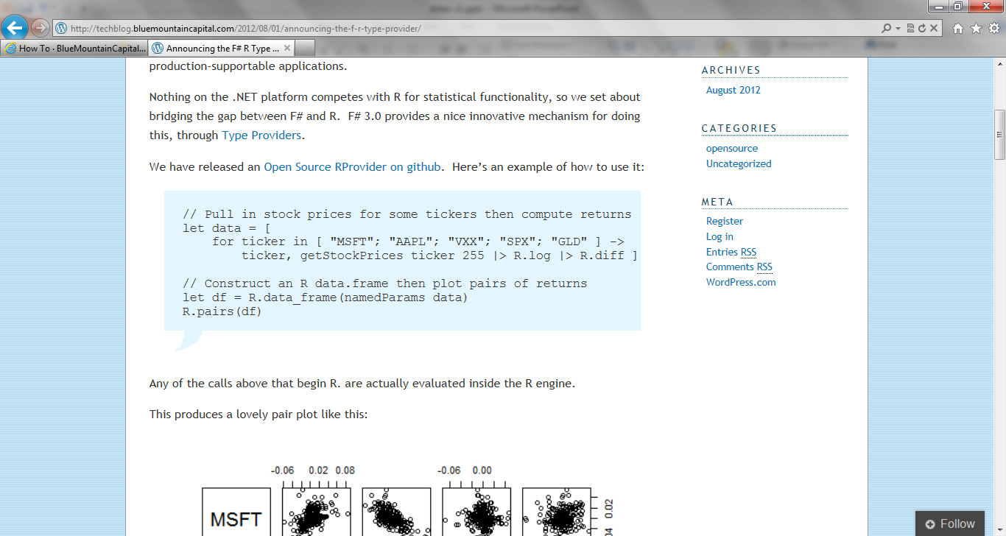
R Provider
google: r provider f#
Open source community provider for interop with R
discovers installed R packages
Access > 2,000 R packages from F#
projects them as .NET namespaces
underneath the parent namespace RProvider

Slide 33
Part 1 – Summary At MSR our job is to take languages forward F# 2.0 focused on analytical programming F# 3.0 focuses on information integration

Slide 34
Part 2 Themes in Information Rich Programming

Slide 35
Recap: the problem…
Languages do not integrate information
Non-intuitive
Not simple
Disorganised
Static
High friction

Slide 36
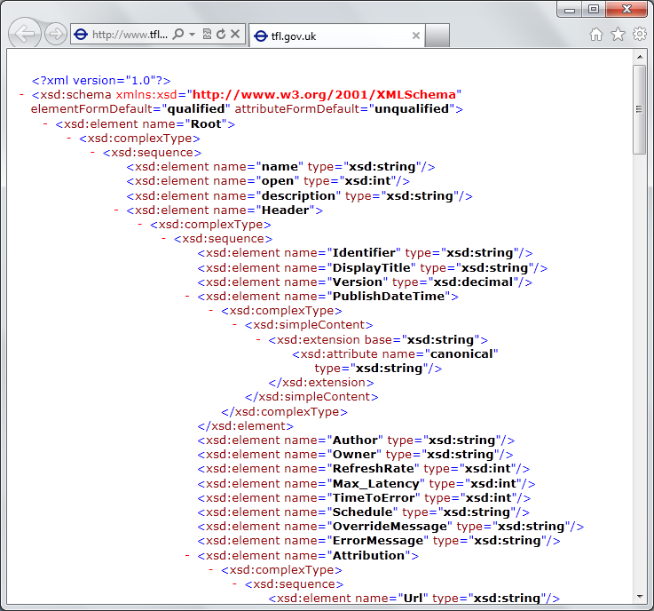
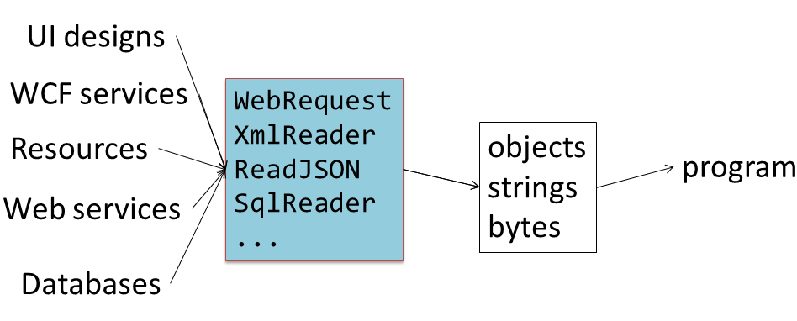
Recap: the problem…
Existing techniques have major problems
Over-reliance on code-generation
Do not scale
No tooling
No strong types
Lowest-common-denominator

Slide 37
Definition #1 Information-rich programming is where external schematized information sources are integral to the operation of the programs being constructed. These may be as simple as textual DSLs embedded as strings in the program itself, as familiar as SQL databases, as massive as a service exposing Wikipedia data, or the world-wide-web of HTML documents itself.

Slide 38
Definition #2 A (strongly-typed) information-rich programming language integrates external information sources, where the schema and content of these sources are presented in a (strongly-typed) idiomatic form

Slide 39
Recap: this is different…
“The idea of integrating internet-scale information services directly into the program's variable and type space that is in F# 3.0 is probably the most innovative programming language idea I have heard of in a decade” (Jim Cordy, Queens U., faculty summit 2012)
Perhaps, perhaps not…
But if something so simple is perceived as so different, take a long think about why
We need to prise apart assumptions

Slide 40


Γ $⊢ e$ : τ
Lots of work here
Lots of work here
The exclusion of reality!
But what about here?
Γ₀ = 0

Slide 41
Theme #1 Big Data → Big Metadata Strongly typed languages and tooling must have a role here, surely!

Slide 42
Theme #2 Huge Information Spaces can and should be viewed as Software Components example: schema change <-> component versioning <-> source compatibility <-> binary compatibility example: software component engineering <-> information space engineering

Slide 43
Theme #3 Multiple Data Standards with One Simple Mechanism Rich type systems, importing rich metadata where it exists

Slide 44
Theme #4 Measure languages by their effectiveness at working with rich external information spaces Example: queries, JSON, XML, type providers, async…

Slide 45
Theme #5 Programming Type Systems v. Information Space Metadata Synergy or Conflict? Examples: Types, Schema, Constraints, Units of Measure, Security Information, Documentation, Definition Locations, Help , Provenance, Privacy, Ratings, Rankings, Search…

Slide 46
Units of Measure from the Web
demo

Slide 47
Some Research Questions
Can provided probabilistic metadata be useful for typing or tooling?
Can we design library/provider mechanisms which incorporate schema change policies?
Can we prove correctness or find bugs in provider components?
Can we provide all the data in the enterprise (e.g. SAP or Microsoft Dynamics)?
Can we plug and play more language logic?
Can we provide and check richer constraints?
Can we build a truly heterogeneous language?
Can security, privacy and provenance annotations be provided?
Can we flow types into the providers?
Can we go mutually recursive?

Slide 48
Summary Internet/enterprise-scale information sources need typed languages that scale
Type provision changes how we think about contextualized programming languages
Many open applied research challenges

Slide 49
Thank you! Questions? dsyme@microsoft.com www.fsharp.net @dsyme #fsharp

Slide 50
taster: units
Notes:
If you would like to host your demo on the Virtual Server, please use the myVPC demo slide, not this slide.

Slide 51

1985
Mirror on underside of shuttle
SDI experiment: The plan
Big mountain in Hawaii

Slide 52
1985
SDI experiment:
The reality

Slide 53
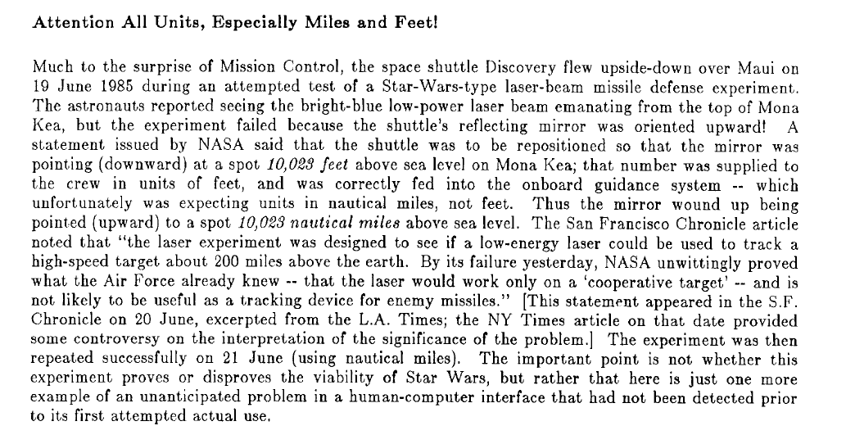
1985

Slide 54
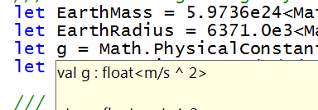
Units of Measure
let EarthMass = 5.9736e24<kg>
// Average between pole and equator radii
let EarthRadius = 6371.0e3<m>
// Gravitational acceleration on surface of Earth
let g = PhysicalConstants.G * EarthMass / (EarthRadius * EarthRadius)

Slide 55
Fundamentals - Whitespace Matters
let computeDerivative f x =
let p1 = f (x - 0.05)
let p2 = f (x + 0.05)
(p2 – p1) / 0.1
Offside (bad indentation)

Slide 56
Fundamentals - Whitespace Matters
let computeDerivative f x =
let p1 = f (x - 0.05)
let p2 = f (x + 0.05)
(p2 – p1) / 0.1

Slide 57
F# - Objects + Functional
type Vector2D (dx:double, dy:double) =
let d2 = dx*dx+dy*dy
member v.DX = dx
member v.DY = dy
member v.Length = sqrt d2
member v.Scale(k) = Vector2D (dx*k,dy*k)
Inputs to object
construction
Object internals
Exported properties
Exported method

Slide 58
Fundamentals - Queries
let avatarTitles =
query { for t in netflix.Titles do
where (t.Name.Contains "Avatar")
select t }
LINQ Queries using
F# workflows

Slide 59
Units of Measure from the Web
demo

Slide 60
CSV Provider
General provider for tabular data
int, bool, float, date, string, etc. options for delimiters, quotes
optional schema optional schema inference
no queries/indexing works with Try F# 3.0
upcoming sample

Slide 61
Meditations on Γ₀
Γ₀ is the ever-growing ocean of digital reality around us
Γ₀ is big. Really big.
Γ₀ defies imagination for its enormity
Γ₀ is other. It doesn’t speak your language
Γ₀ is being organized at an incredible rate
Γ₀ is just ready and waiting to be tamed. (We’re hitting the limit with e and tau)
Γ₀ is surprisingly “human”

Slide 62
Meditations on Γ₀
Γ₀ is full of uncertainty and probabilities.
You are mutually recursive with Γ₀. You are part of it.
Γ₀ has many open doors, many locked doors
Γ₀ has many, many parts that do not get on particularly well.
Γ₀ is so real you want to touch it, explore it
In the enterprise, Γ₀ is the enterprise data context

Slide 63
Paradigm Locator
Statically Typed
Dynamically Typed

Slide 64
Paradigm Locator
Statically Typed
Dynamically Typed
A major search is on!
make statically typed langs more dynamic
make dynamically typed langs more static
moderate static typing in limited ways

Slide 65
What’s to wrestle with
Scale
Sparseness
Breadth of application
Ease of authoring provider components
Incremental and mutually recursive type provision
Meaning of soundness and correctness in a heterogeneous, evolving world
Next directions, concretely

Slide 66
Recap: this is different…
We like to see PL systems as purely logical systems
Traditional logical systems exclude interaction with reality
This is a powerful and simplifying assumption
It is also fundamentally wrong for modern applied programming languages

Slide 67
The Freebase Provider
blogs.msdn.com/fsharp
Freebase is API to (some of) Google Knowledge Graph
20 million objects, 3 million books, 300K films, …
GET/POST to http://api.freebase.com, JSON back
MQL query language & entity model
Data usable in app programming and elsewhere
Sample Freebase provider
maps “commons” into .NET types/values top level organization by type
read-only access works with Try F# 3.0
multiple inheritance snapshot dates
query translation connects to latest Google API
units of measure propagation sample individuals
better organization
released as sample

